Slide 1
Moore’s Law
What Fueled Performance Increases in Processors between 1974-2004?
© 2018 L. V. Kale at the University of Illinois Urbana-Champaign

Slide 2
Clock Speeds
In our simple computer:
A single program instruction is executed in a “clock cycle”
clock period

Slide 3
Components of a Stored-Program Computer
Instruction Memory
Data Memory
PC (Program Counter)
Move to the next location
Register set
ALU
Instruction
In one clock cycle: instruction is fetched from memory, operands fetched, arithmetic performed, results stored back
Notes:
Ideally, we should have a little animation of a clock cycle, with a bright-tiny circle tracing the clock.

Slide 4
Clock Speeds
In our simple computer:
A single program instruction is executed in a “clock cycle”
Instruction is fetched from memory, operands fetched, arithmetic performed, results stored back
Clock time period is selected so that the parts of the computer can finish basic calculations within the cycle
Two properties of switches and gates:
Size
Switching and propagation delay
If we can make transistors smaller
Which means smaller capacitances
Imagine filling up “tanks” with “water” (electrons)
We can turn them on or off faster
Which means we can make our computers go faster

Slide 5
The Virtuous Cycle
If you can make transistors smaller:
You can fit more of them on a chip
Cost per transistor decreases
AND: propagation delays get smaller
So they can run faster!
Can you make them smaller?
Technological progress needed, but can be done
This led to:
Cheaper and faster processors every year

Slide 6
Moore’s Law
Commonly (mis)stated as
“Computer performance doubles every 18 months”
Gordon Moore observed in 1965
“The complexity… has increased roughly a factor of two per year. [It] can be expected to continue…for at least 10 years”
It’s about number of transistors per chip
It is an empirical observation and an expectation
Funny thing is: it held true for 50+ years
And still going until 2020
“Self-fulfilling prophecy”

Slide 7
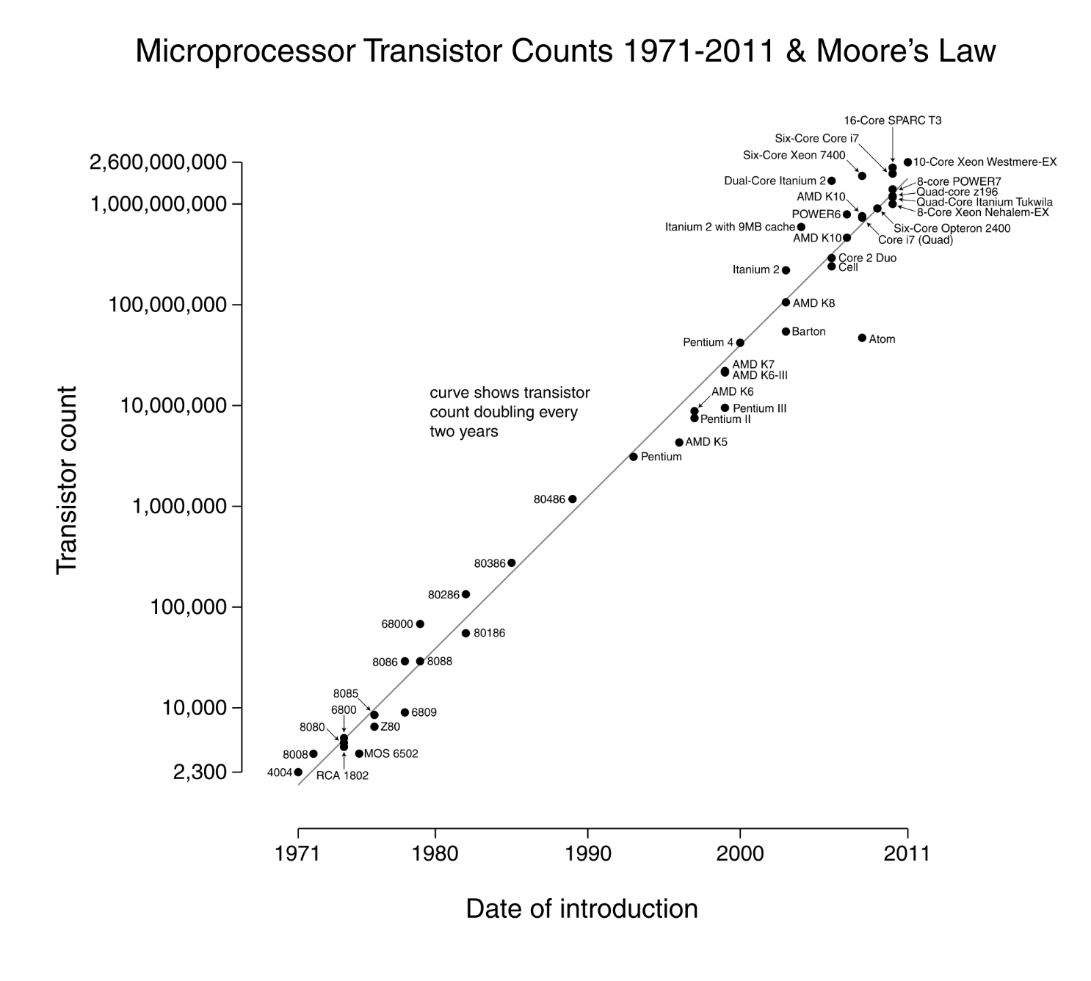
(Wgsimon, 2011)

Slide 8
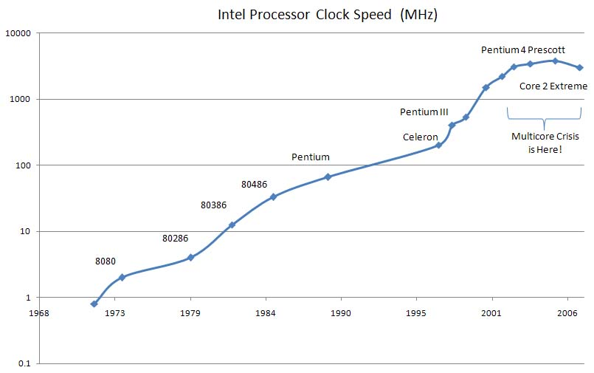
Clock Speeds Increased
Intel Processor Clock Speed (MHz)
(Warfield, 2007)
Notice a little trick: x axis goes only to 2003!

Slide 9
Until They Stopped Increasing!
Intel Processor Clock Speed (MHz)
Why?
(Warfield, 2007)

Slide 10
Prediction in 1999 From Shekhar Borkar, Intel, at MICRO’99
So, the chips were getting too hot

Slide 11
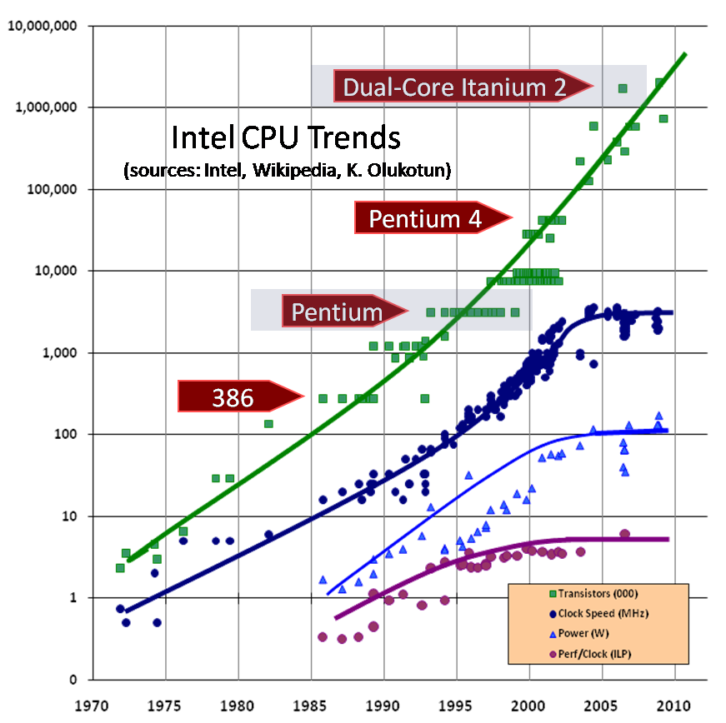
Transistors / chip
Clock Frequency
Power
(Sutter, 2009)
Also see: https://www.karlrupp.net/2015/06/40-years-of-microprocessor-trend-data/
Notes:
Need to find the original source and credit. See https://www.karlrupp.net/2015/06/40-years-of-microprocessor-trend-data/
And https://science.energy.gov/~/media/ascr/ascac/pdf/reports/2013/SC12_Harrod.pdf slide 12

Slide 12
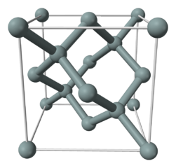
Number of Transistors/Chip?
Well, they will keep on growing for the next several years
May be a bit slowly
Current technology is 10-14 nanometers
AMD EPYC 7401P (19.2 billion transistors on 4 dies on the package)
10 nm
We may go to 5 nanometers feature size
I.e., gap between two wires (as a simple definition)
For comparison:
Distance between a carbon and a hydrogen atom is 1 angstrom = 0.1 nanometer!
Silicon-silicon bonds are longer
5 Aº lattice spacing (image: Wikipedia)
I.e., 0.5 nanometer
So, we are close to atomic units!

Slide 13
Consequence
We will get to 30-50 billion transistors/chip!
Even in 2006, Pentium 4 last edition had 185M transistors
What to do with them?
We will learn later about what was done between 1973-2003 with this bounty of transistors to improve performance
And its consequences for performance oriented programming
But then, around 2003, all these methods, including increasing on-chip memory (caches), etc., ran to dead end

Slide 14
References
Sutter, H. (2009). Intel CPU introductions [Online image]. The Free Lunch Is Over: A Fundamental Turn Toward Concurrency in Software. Retrieved from http://www.gotw.ca/publications/concurrency-ddj.htm
Warfield, B. (2007). A picture of the multicore crisis [Online image]. SmootheSpan Blog. Retrieved from https://wp.me/p4HAY-1j
Wgsimon. (2011). Transistor count and Moore’s law - 2011.svg [Online image]. Retrieved from https://goo.gl/MhS2gP

